Slide 1
LPCC Lab Assignment -1 Assembler Pass-I
WEEK 4 Task : Assembler Pass-I
For a given sample ALP code, generate Symbol Table(ST), Literal Table(LT), Pool Table(PT) and Intermediate code (IC) Table / File; and print ST, LT, PT, IC

Slide 2
Intermediate Code IC (and Variants)

Slide 3
Input Required
EMOT
Mnemonic | Class | Opcode
STOP | 1 | 00
ADD | 1 | 01
SUB | 1 | 02
MULT | 1 | 03
MOVER | 1 | 04
MOVEM | 1 | 05
COMP | 1 | 06
BC | 1 | 07
DIV | 1 | 08
READ | 1 | 09
PRINT | 1 | 10
START | 3 | 01
END | 3 | 02
ORIGIIN | 3 | 03
EQU | 3 | 04
LTORG | 3 | 05
DS | 2 | 01
DC | 2 | 02
AREG | 4 | 01
BREG | 4 | 02
CREG | 4 | 03
EQ | 5 | 01
LT | 5 | 02
GT | 5 | 03
NE | 5 | 04
LE | 5 | 05
GT | 5 | 06
ANY | 5 | 07
Type | SYMBOL | VAL. OF CLASS FIELD
Imperative Statements | IS | 1
Declarative Statements | DL | 2
Assembler Directive | AD | 3
CPU Register | RG | 4
Conditional codes | CC | 5

Slide 4
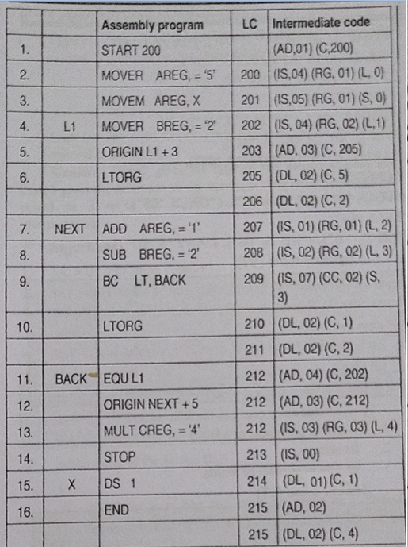
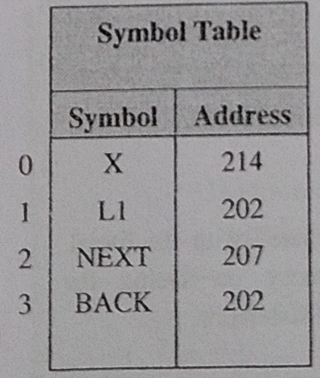
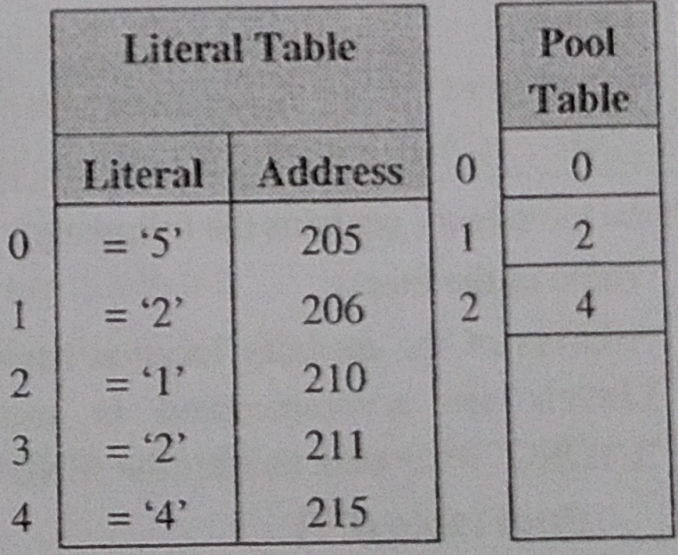
Sample1: Input Program (Source Code)
and its corresponding Intermediate Code (IC)

Slide 5
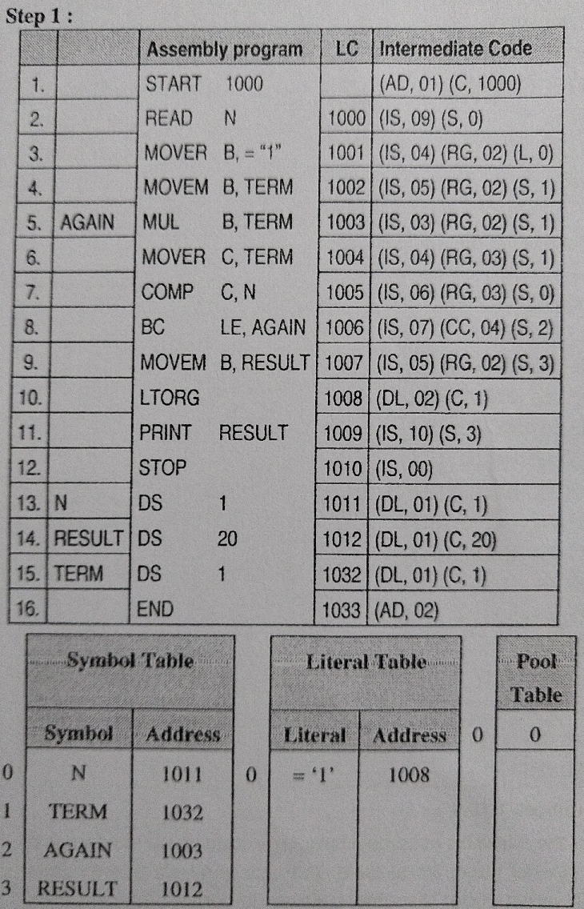
Sample2: Input Program (Source Code)
and its corresponding Intermediate Code (IC)

Slide 6
Assembler Pass I

Slide 7
Data Structures for Pass I
Literal Table (LT)
struct LiteralTab
{
int literal;
int address;
} LT[10];
Pool Table (PT)
int PT[10];
Enhanced MOT
Mnemonic | Class | Opcode
STOP | 1 | 00
ADD | 1 | 01
SUB | 1 | 02
MULT | 1 | 03
MOVER | 1 | 04
MOVEM | 1 | 05
COMP | 1 | 06
BC | 1 | 07
DIV | 1 | 08
READ | 1 | 09
PRINT | 1 | 10
START | 3 | 01
END | 3 | 02
ORIGIIN | 3 | 03
EQU | 3 | 04
LTORG | 3 | 05
DS | 2 | 01
DC | 2 | 02
AREG | 4 | 01
BREG | 4 | 02
CREG | 4 | 03
EQ | 5 | 01
LT | 5 | 02
GT | 5 | 03
NE | 5 | 04
ANY | 5 | 05
Machine Opcode Table (MOT) ENHANCED
struct EMOTtable
{
char Mnemonic [6];
int Class;
char Opcode[3];
};
Struct EMOTtable MOT[28];
Symbol Table (ST)
struct symbol table
{
char Symbol[8];
int address;
int size;
}ST[20];
Meaning of Class Field
Type | SYMBOL | VAL. OF CLASS FIELD
Imperative Statements | IS | 1
Declarative Statements | DL | 2
Assembler Directive | AD | 3
CPU Register | RG | 4
Conditional codes | CC | 5

Slide 8
Intermediate Code (IC) table
struct intermediatecode
{
int LC;
int code1,type1; //code1=index in MOT,type1= 1/2/3
int code2,type2; //Similar for 2nd symbol
int code3,type3; //Similar for 3rd symbol
} IC[30];

Slide 9
Assembler Pass I - Algorithm
LC =0;
iPT=0;
PT[iPT]=0;
iLT=0;
Open Source code
While(!EOF)
Read nextline and store in char array “nextline” and convert to UPPER CASE
If nextline is END break;
If nextline has label store in ST
Separate code and operand into S1,S2,S3
If declarative statement in “nextline” correctly update type1,code1, size and add in IC table. Increment LC=LC+size
f. If imperative statement in “nextline” update type1,code1 and size. If literal, then add to literal table. Increment LC=LC+size and generate intermediate code. Add to IC table.
g. If LTORG, then assign address to current pool of literals, iPT=iPT+1, PT[iPT]=iLT, modify LC
h.If START or ORIGIN, LC updated suitably and IC code stored in IC table
If EQU, address in ST is corrected. IC statement stored in IC table
7. At the end perform 6(g) and go to pass II

Slide 10
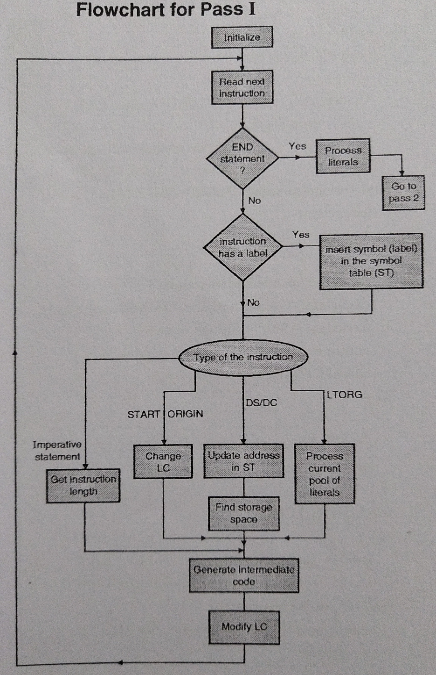

Slide 11
START 200
MOVER AREG,=‘5’
MOVEM AREG,X
L1 MOVER BREG,=‘2’
ORIGIN L1+3
LTORG
NEXT ADD AREG,=‘1’
SUB BREG,=‘2’
BC LT, BACK
LTORG
BACK EQU L1
ORIGIN NEXT+9
MULT CREG, X
STOP
X DS 1
END
(LC =200)
200
201
202
(LC=205)
(LC=205)
207
208
209
(210,’1’)
(211,’2’)
212
LC=216
216
217
218
SYMBOL TABLE (ST)
SYMBOL | ADDRESS
L1 | 202
NEXT | 207
BACK | 212/202
X | 215
0
1
2
3
<-STN
LITERAL TABLE (LT)
VALUE | ADDRESS
=‘5’ | 205
=‘2’ | 206
=‘1’ | 210
=‘2’ | 211
0
1
2
<-LTN
3
POOL TABLE
LITERAL NUMBER
0
2
0
1
<-PTN

Slide 12
Thank You!!

